Slide 1
Infrastructure Investment⎯
Saving Grace for Insurers?
Keynote Address
23rd IAIS Annual Conference
Joaquim Levy
Managing Director and CFO
World Bank Group
Asunción, Paraguay
11 November 2016
Disclaimer: The views expressed in this presentation are those of the presenter and do not necessarily represent those of the World Bank or World Bank policy. Any errors are those of the presenter.

Slide 2
Current macro challenges require a bold and strategic response that helps improve global welfare and share prosperity.
Global growth still feeble and uneven as global imbalances continue to rise
  Lower oil prices and monetary easing in advanced economies supported private spending, but investment yet to recover
  Emerging market economies expected to lift global growth but commodity exporters struggle to adjust to low commodity prices and domestic headwinds
High political and policy uncertainty
Pressing global problems of climate change and forced displacement

Slide 3
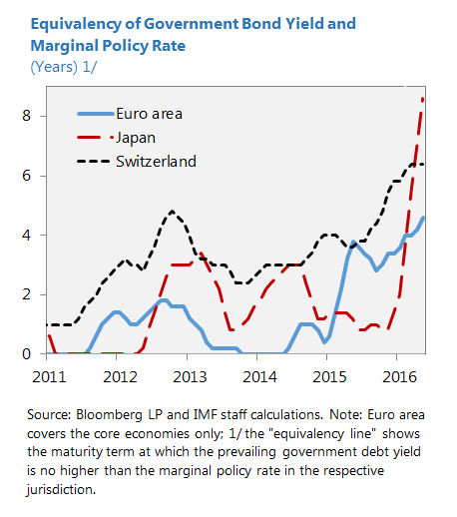
Euro area investors need to hold core sovereign debt for up to five years just to break even with the prevailing policy rate!

Slide 4
Infrastructure investment could hold the key to resolving the current stagnation …
Low rates a reflection of secular stagnation
  Insufficient aggregate demand due to structural gaps (e.g., ageing populations, productivity)
  Current patterns of investment do not deliver returns required to support sustainable rates of growth
Private cross-border investment, particularly in infrastructure, effective in reducing current imbalances
  Directing excess long-term private savings towards emerging markets creates long-term income streams to investors in advanced economies.
Potential of higher returns could satisfy search for yield.

Slide 5
For life insurers, current macro conditions have become a key challenge, affecting both strategic and business model decisions.
Urgent dilemma in the grip of a low-rate environment:
  Extend the maturity of assets
  Invest in riskier assets that yield higher returns if low (and declining) interest rates increase the value of liabilities, or
  Do nothing and accept the rising effective leverage
Infrastructure investment in emerging markets can mitigate risk of low interest rates.
  Natural interest in infrastructure as long-term asset yielding predictable cash flows, with low correlation to other assets.
  “Illiquidity premium” increases discount rate of best estimate liabilities.

Slide 6
Surprisingly, direct financing of infrastructure projects is not a major constituent of insurers’ investment portfolios.
(Re)insurers in OECD countries have about $23 trillion of assets (~25% of global GDP) but allocate only about 2.5 percent to infrastructure investment.
Potentially greater role insurance companies as investors in infrastructure:
  Lower appetite of banks as traditional lenders due to Basel III
  Limited fiscal space has led to lower government spending on capital investment

Slide 7
However, there are a number of challenges in funding infrastructure projects.
Infrastructure investments can be highly complex to manage
  Limited supply of cash-generating secondary phase projects has led insurers to explore more complex and risky primary phase and/or equity-based infrastructure investments.
Information constraints
Regulatory barriers not the primary reason for low infrastructure investment but regulation is evolving and varies globally
  Prudential treatment should recognize that most infrastructure investment seems less risky than traditional asset classes, including in emerging markets.

Slide 8
Current capital charges under Solvency II illustrate that, at current market prices, insurers would have regulatory incentive to invest in infrastructure.

Slide 9
Defining the role of the World Bank …
The World Bank tries to lower the gap between investor risk appetite and riskiness of infrastructure investment in EMs:
  Help governments develop a favorable legal environment and prepare projects, thus, lowering existing informational hurdles.
  Make the range of World Bank guarantees, both at project and portfolio level, more understood and understandable; also political risk insurance (via MIGA).
  Help create tools, such as infrastructure fixed income indexes, to position infrastructure investments in the risk/reward space, as well as support local capital market development.

Slide 10

Thank you!
Questions?

