Slide 1


IAIS Annual Conference Panel
Leveraging insurance for sustainable growth and development
APFF work on insurance and retirement income
to support sustainable growth and development in the Asia Pacific region
Makoto Okubo, Nippon Life Insurance Company
Sherpa, APFF Insurance and Retirement Income Work Stream
Asuncion, Paraguay, 11 November 2016

Slide 2
APFF: Public-private collaboration in developing financial systems
APFF (Asia Pacific Financial Forum)
Importance of regional public-private collaboration:
  Legal and regulatory frameworks
  Financial market infrastructure
  Financial market integration
APFF: informal, inclusive and advisory public-private platform for collaboration in the development of common strategies for developing sound, efficient and integrated Asia-Pacific financial markets
  Governments and regulatory bodies
  Private sector
  International organizations (IFIs, SSBs, others)

Slide 3


APFF Insurance and Retirement Income Work Stream
APFF Progress Report 2016
Expanding the Region’s Long-Term Investor Base
Pension/Protection
Infrastructure/Investment
Regulatory/Accounting
Strengthening Financial Resilience
Disaster Risk Financing
Micro-Insurance

Slide 4
Roadmap for the Sustainable Development
Liabilities
ALM
Assets
Long Term Returns
Long Term Investments
Infrastructure Projects
CONSUMERS
INSURERS AND
PENSION FUNDS
Capital Market
Regulation Accounting
Disaster Risk Financing
GOVERNMENT
Addressing the Aging Tsunami
Retirement Income & Longevity Solutions
Capital Market and Long Term Investments
Promote Sustainable Economic Development & Resilient Infrastructure
Enhance Disaster Risk Financing
Enhance Financial Inclusion
Reduce Fiscal Liabilities
Enhance Sovereign Rating

Slide 5

Pension/Protection
Mandatory provisions and scalable retirements systems
Tax incentives to promote long-term saving products
Product innovation and financial awareness

Slide 6

Infrastructure/investment
Promotion of infrastructure as a defined asset class
Increased fiscal spending on infrastructure projects
Adoption of financing vehicles within PPP framework

Slide 7

Regulation/Accounting
Regulatory issues
Bank-centric regulations
Short-term oriented economic regime
“One-size-fits-all” model
Remaining key accounting issues
Unit of account
Scope for “variable fee approach”

Slide 8
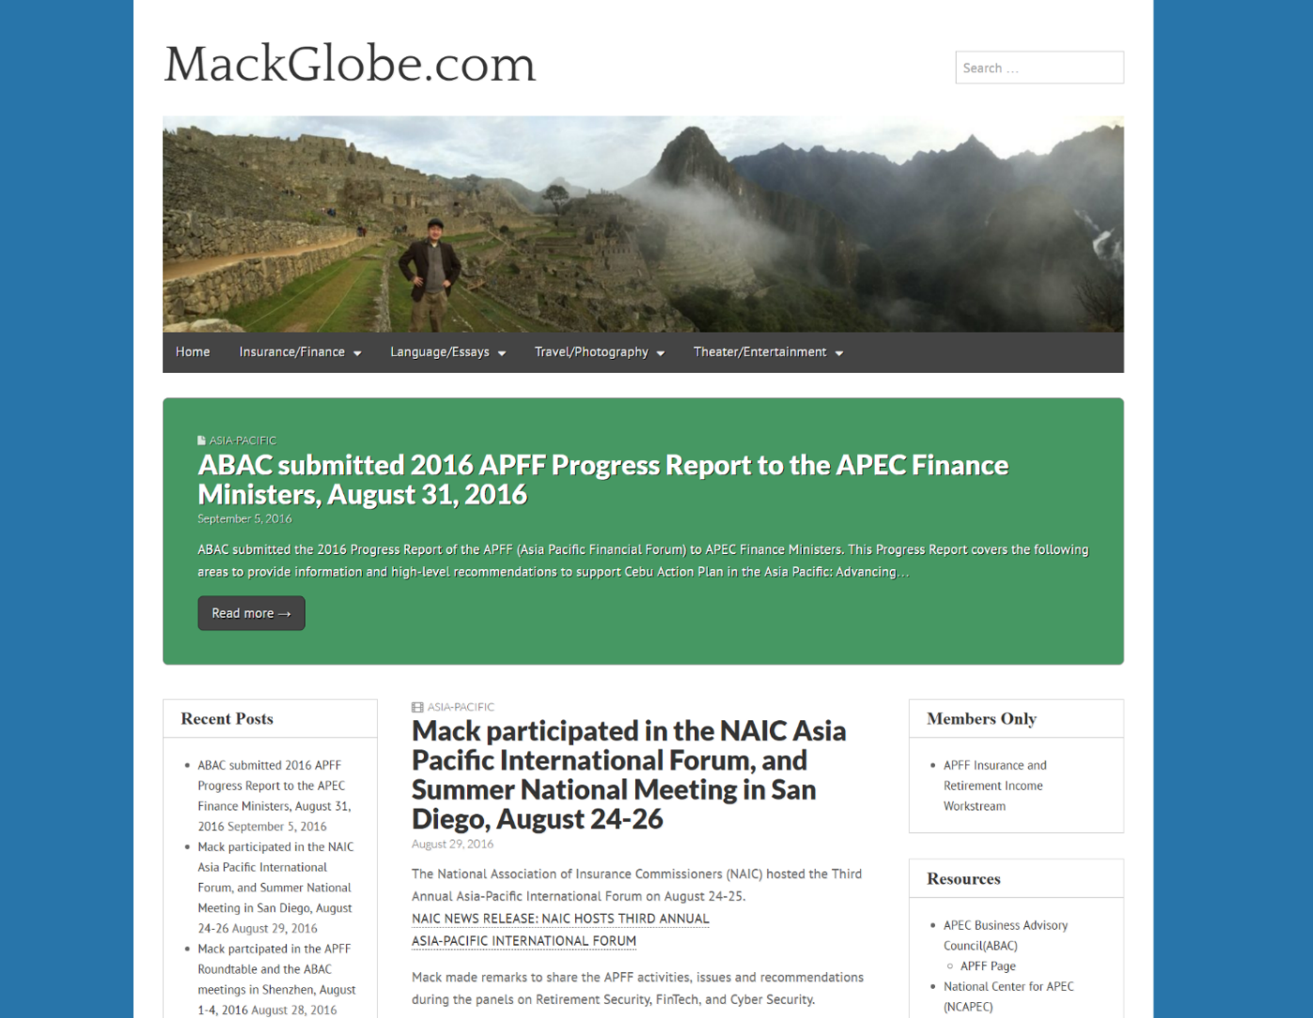
Asia Pacific Financial Forum (APFF)
Insurance and Retirement Income Work Stream
  For more details on the APFF, visit mackglobe.com or email
  Makoto Okubo (m-okubo@nipponlifeglobal.com)
Notes:
7

