Slide 1
Leveraging Insurance for Sustainable Growth and Development
Panel Discussion
23rd IAIS Annual Conference
Andreas (Andy) Jobst
Adviser to the Managing Director and CFO
World Bank Group
Asunción, Paraguay
11 November 2016
Disclaimer: The views expressed in this presentation are those of the presenter and do not necessarily represent those of the World Bank or World Bank policy. Any errors are those of the presenter.

Slide 2
Overview of Insurance Agenda at the World Bank Group
Technical Assistance
  Regulation and supervision in developing economies (incl. crisis management, consumer protection)
Standard Setting and Implementation
  IAIS (FSC, TC, Market Conduct WG, Governance WG); also adaptation of ICPs (Regional Implementation Plan)
  ICP assessment (and/or Insurance Development Module) and insurance stress testing in FSAPs
Financial Inclusion (via insurance projects)
  Market development: Largely donor-funded risk absorption capacity (Disaster Risk Finance, Agriculture Insurance Program)
  Mobilization: unfunded credit protection (MCPP facility) and reinsurance (e.g., Africa Energy Pool)

Slide 3
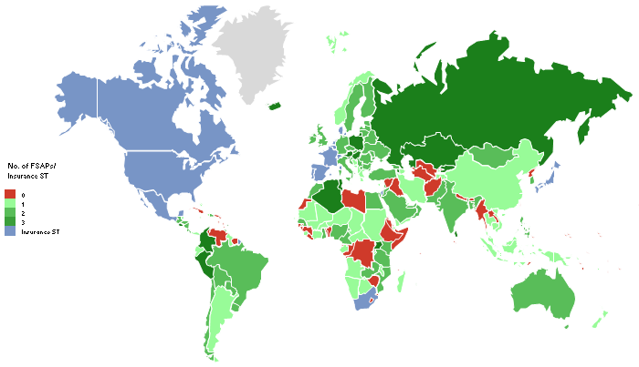
Standard Setting and Implementation
FSAP Stress Testing: … used to be rare in FSAPs (relative to incidence of banking sector coverage)
Overview of FSAPs* and Completion of Insurance Stress Tests (2000-14)
Number of Insurance Stress Tests in FSAPs* (before/after financial crisis)
Source: Jobst, Sugimoto and Broszeit (2015). Note: (*) includes full FSAPs, FSAP Updates, and Stability Modules (incl. reviews under the Offshore Financial Center (OFC) Assessment Program). The overview does not show the insurance stress tests completed as part of the FSAP/standards assessment for Bermuda, Guernsey, and the Isle of Man. Belgium, France, Japan, and Singapore are the only countries that have completed two FSAP insurance stress test exercises so far.
Source: Jobst, Sugimoto and Broszet (2015). Note: (*) Total number comprises full FSAPs, FSAP Updates, and Stability Modules (incl. all countries subject to the Offshore Financial Center (OFC) Assessment Program with a stress testing exercise) but excludes three (out of a total of 25) insurance stress tests that have not been published.

Slide 4
Financial Inclusion
Disaster Risk Financing and Insurance Program (DRFIP): Objective
Financial impact of disaster on recovery dynamics, socio-economic progression, and inequality but many countries lack sufficiently developed insurance markets
  Limits lending opportunities and identification WBG projects
  Challenge to WBG twin goal of eliminating extreme poverty and raising shared prosperity
Closing the protection gap and promoting better risk management
  Pricing risk creates incentives for investing in prevention and preparedness
  → strengthen resilience before disasters occur
Objective: Enhance financial response capacity through higher efficiency (cost/time) of post-disaster funding

Slide 5






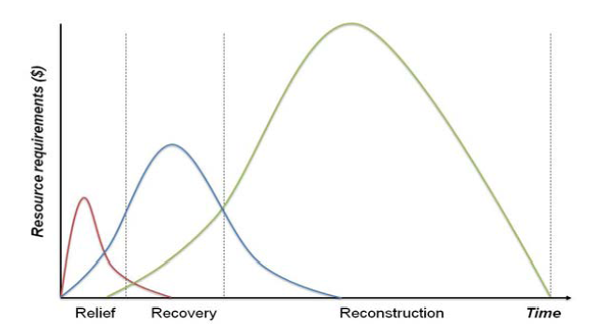
Financial Inclusion
Disaster Risk Financing and Insurance Program (DRFIP): Scope
Market Development
Sovereign Disaster Risk Finance
Farmers & Herders
Homeowners & SMEs
DRF for
Rapid Response Financing
DRF for Budget Protection
DRF for
Resilient Livelihood
DRF for Agriculture
DRF for Property Cat Insurance
$
DRF Analytics for Financial Decision-Making
DRF Knowledge Management and Global Partnerships
Enhance efficiency from grant-making to executed activities
Move from top-down, parametric insurance coverage for sovereigns to indemnity-based retail distribution

Slide 6
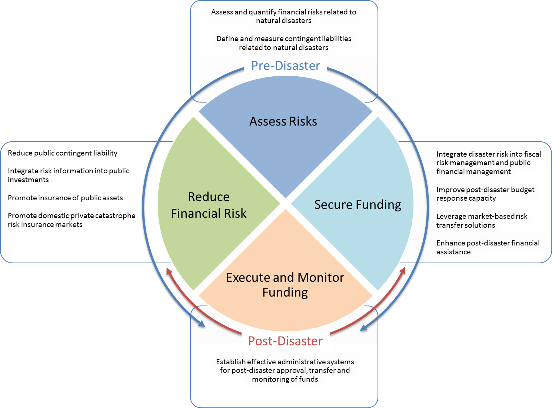

Financial Inclusion
Disaster Risk Financing and Insurance Program (DRFIP): Operational Framework

Slide 7
Financial Inclusion
Disaster Risk Financing and Insurance Program (DRFIP): Incentives and Innovation
Incentive problem of sovereigns
  Moral hazard (bail-out, materialization outside electoral cycle)
  Self-insurance and “unpriced” contingent liabilities
  Common pool problem affecting budgetary allocation
Innovative financial products combining insurance and other complementary risk-sharing tools
  Contingent loans (CAT DDO), CAT bonds/swaps, and capital-at-risk notes
  Creation of regional pools
    Pacific Catastrophic Risk Assessment and Financing Activity (PCRAFI), together with GFDRR

Slide 8
Financial Inclusion
Disaster Risk Financing and Insurance Program (DRFIP): Necessary Conditions for Higher Penetration
Probabilistic cat models, fully adapted to the country characteristics
Create and maintain high-quality databases (exposure and losses)
Enhanced (re)insurance supervision/regulation:
  Dynamic financial analysis/risk analytics
  Strong technical basis of pure premium and risk transfer chain
  Capital requirements
  Provisioning/reserving practices
  Outwards reinsurance requirements
  Competition among local insurers
  Promotion of new products to serve particular segments

Slide 9
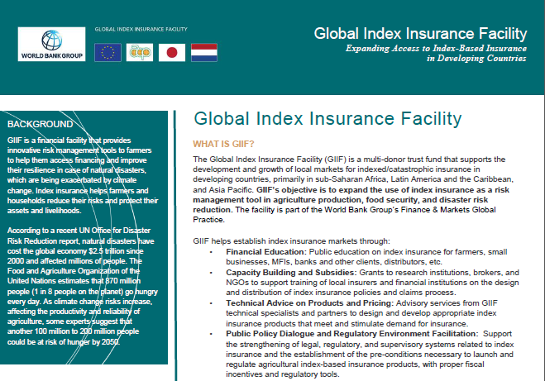
Financial Inclusion
Agriculture Insurance Program (GIIF)
Pilot Phase (2010-15): Working concepts, e.g., crop insurance
Going forward:
  Risk transfer schemes at regional level to provide cost-effective and timely (re)insurance capacity
  Focus on cash crops specific to national/regional food security agendas
    Data infrastructure (ground-based weather stations/satellite data)
    Timely farming information
    Fiscal incentives and regulations

Slide 10

Thank you!
Questions?

