Slide 1
Technological Innovation
Insurance Supervision and the Business of Insurance
David McGown
Senior Vice President, IBC

Slide 2


Insurance Insulated from Disruption …so far
…unlike the hotel and taxi sectors

Slide 3
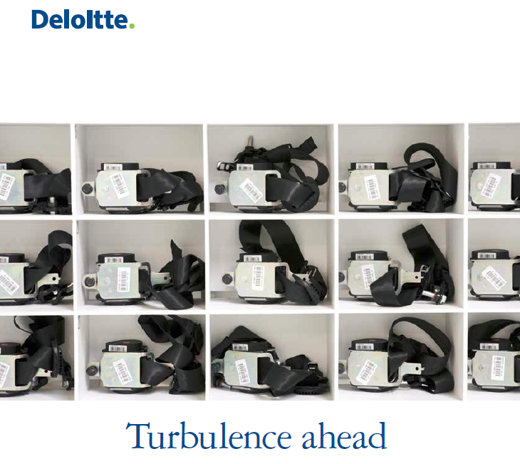
Structural Implications for P&C

Slide 4

Positive experiences with their insurers
34%
55%
Under 35
Over 35
Source: World Insurance Report

Slide 5
Two Types of Innovation
Direct
Peer to Peer
Other (Inspeer)
Small networks that syndicate deductibles
Re-thinks insurance from the customer’s point of view
Indirect
Innovation affects underwriting, pricing and selling
Into traditional insurance markets

Slide 6
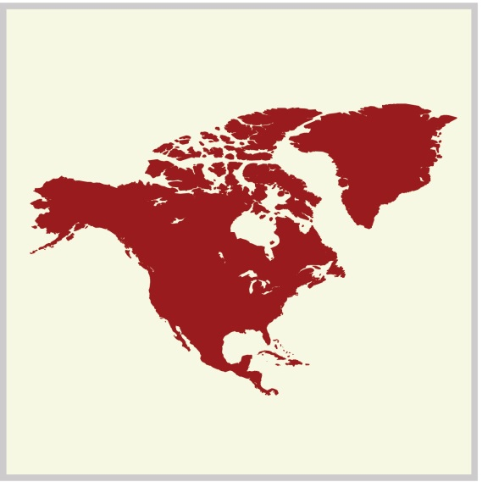

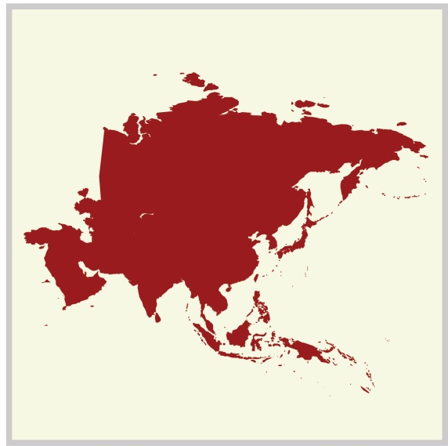
Three Forces Affecting Insurers
Personal and Commercial lines are no longer bookends of the business
Customers want event-based insurance
Technology and big data lead to individual risk-managed pricing

Slide 7

GFIA Working Group
What role
can associations
play?

Slide 8

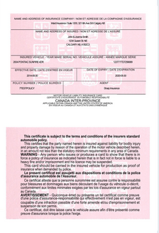
Consumers are There … Whether or Not Permitted by Regulation

Slide 9
The Duty of Regulators
Protect consumers
Enable innovation

Slide 10



Regulation that is Technology-Agnostic

Slide 11
Technological Innovation: Insurance Supervision and the Business of Insurance
David McGown
Senior Vice President, IBC

